Slide 1
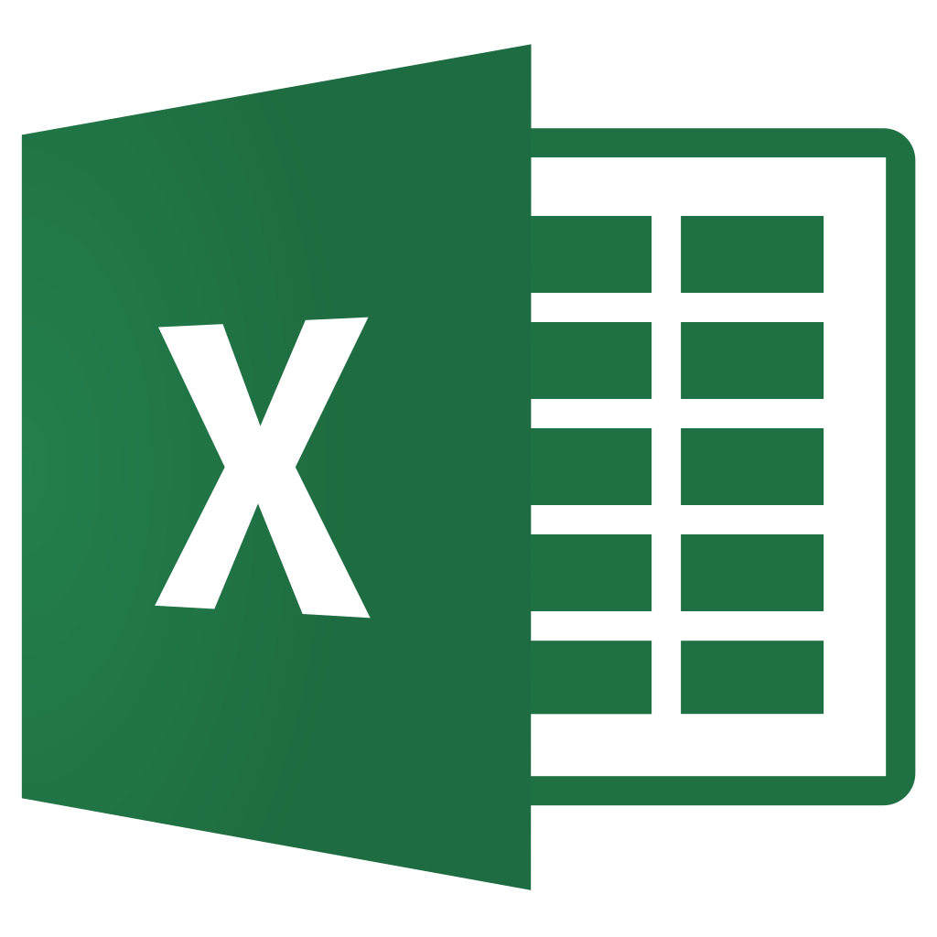

What is Keras?

Slide 2

Neural network library in Python built on TensorFlow
Allows fast experimentation on deep neural networks

Slide 3
Deep neural network

Slide 4

What is TensorFlow 2?
An open-source software library
Developed by Google

Slide 5
Its math library is often used for neural networks
TensorFlow 2 offers easy model building

Slide 6
Good starting point in Keras is the Sequential model:
A plain stack of layers where each layer has 1 input tensor and 1 output tensor.

Slide 7
What is Keras? ✓
Let’s begin...

